Slide 1
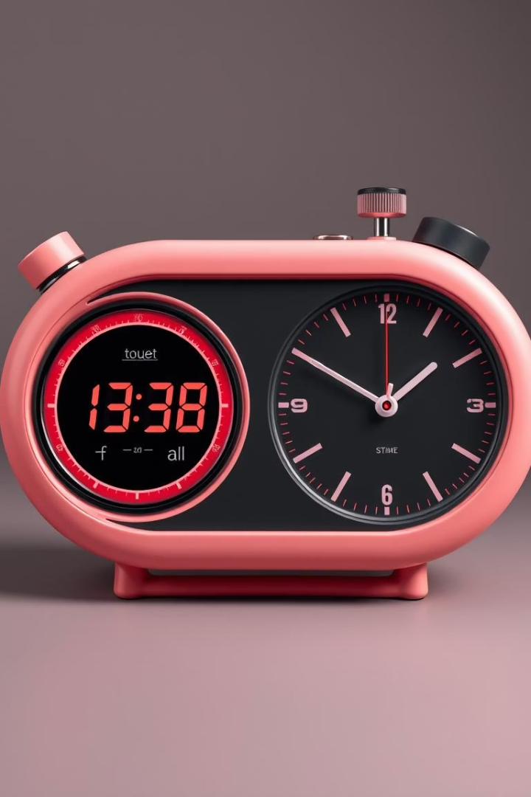

12: Stop Watch / Clock - A Timekeeping Duo
This presentation explores the innovative blend of a stopwatch and a clock into a single, versatile application. Discover its features, benefits, and diverse applications.
by Kavya Sree

Slide 2
What is a Stop Watch / Clock Application?
It's a digital tool combining time measurement and current time display. Users can track elapsed time. They can also view the precise current time.
Stopwatch Mode
Clock Mode
Measures intervals precisely. Ideal for activities requiring timing.
Displays accurate current time. A practical daily utility.

Slide 3
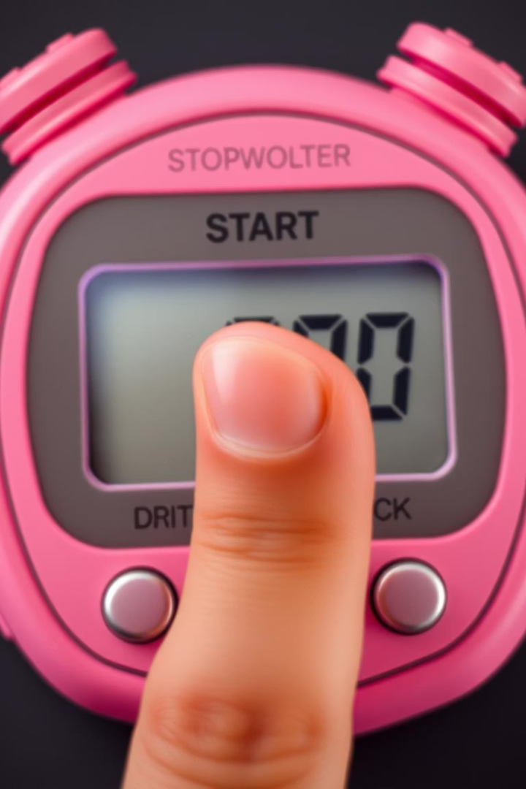

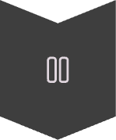

Stop Watch Functionality: Start, Stop, Reset Demystified
The stopwatch feature offers simple controls. Users initiate, pause, or clear measurements. This ensures accurate tracking of time.
Start
Begin elapsed time measurement.
Stop
Pause current time measurement.
Reset
Clear time, return to zero.

Slide 4
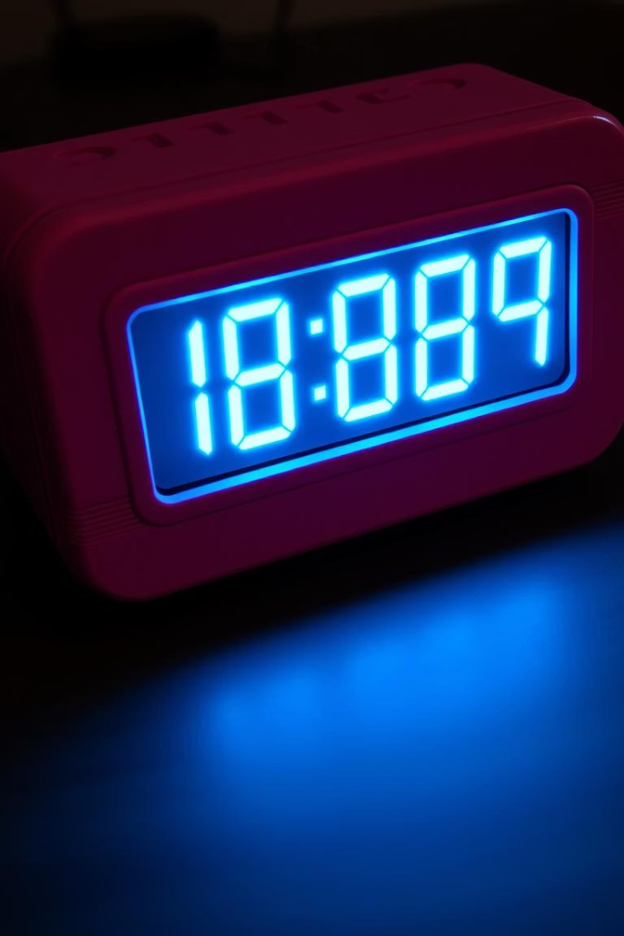



Clock Functionality: Keeping Time in the Digital Age
The clock component provides current time. It displays hours, minutes, and seconds. This feature ensures users are always on schedule.
Real-Time Display
Time Zone Support
Shows time constantly, accurately.
Adjusts for global locations.
Date Integration
Often includes current date.

Slide 5
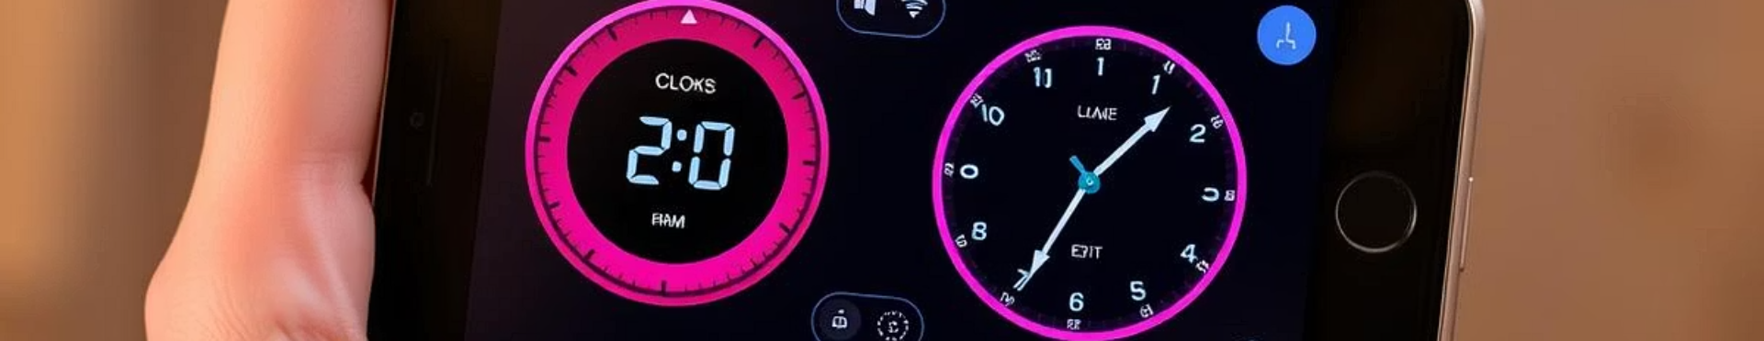
Key Features & Benefits of Combining Both
Integrating both functions offers significant advantages. It provides convenience and versatility. Users gain a comprehensive timekeeping solution.
Enhanced Efficiency
Space Saving
Multi-Purpose Use
Switching modes is seamless. Saves time and effort.
Combines two tools in one. Reduces clutter on screen.
Handles diverse timing needs. From daily tasks to specific events.

Slide 6
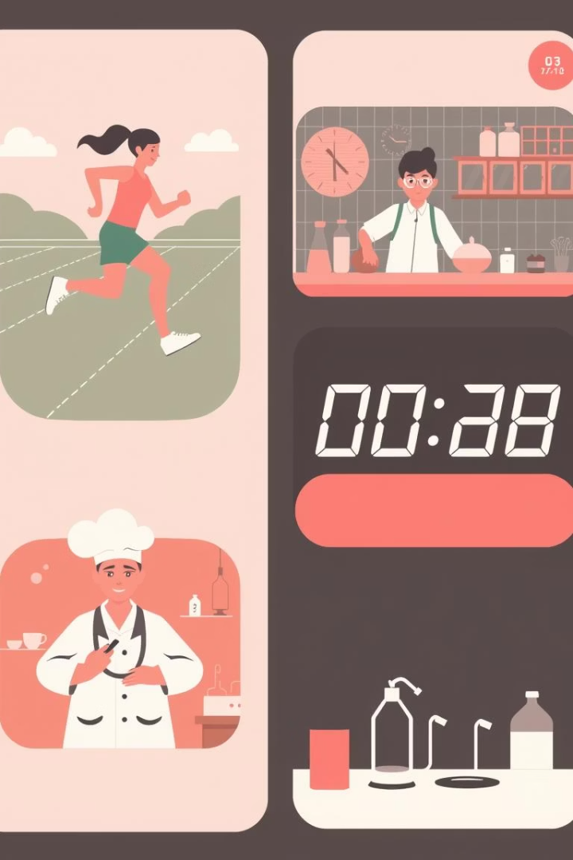




Use Cases: From Sports to Cooking and Beyond
This combined tool serves many purposes. It is useful in diverse fields. From athletic training to precise kitchen timings, its applications are widespread.
Athletics
Cooking
Workouts
Timing sprints and laps.
Baking and recipe timings.
Interval training sessions.
Labs
Experiment time tracking.

Slide 7
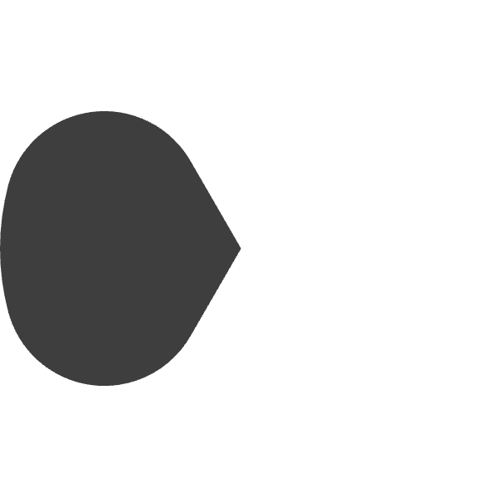
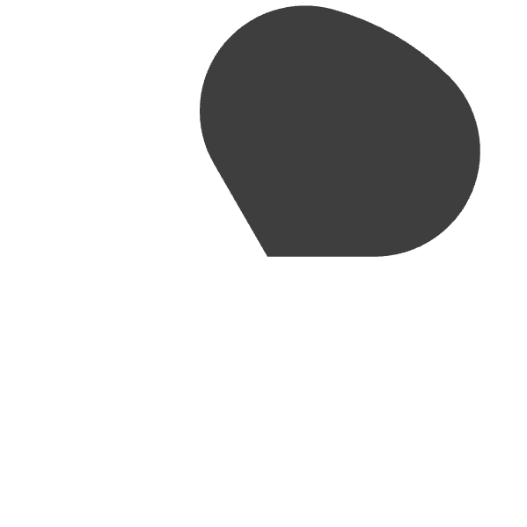
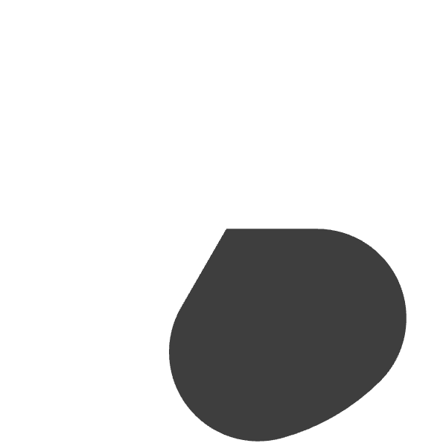



Interface Design: Balancing Clarity and Functionality
Effective design is crucial. It ensures user-friendliness. A clear layout promotes easy navigation and optimal use.
Intuitive Controls
Simple buttons for actions.
Legibility
Large, clear digits for easy reading.
Minimalist Layout
Clean design, no clutter.

Slide 8
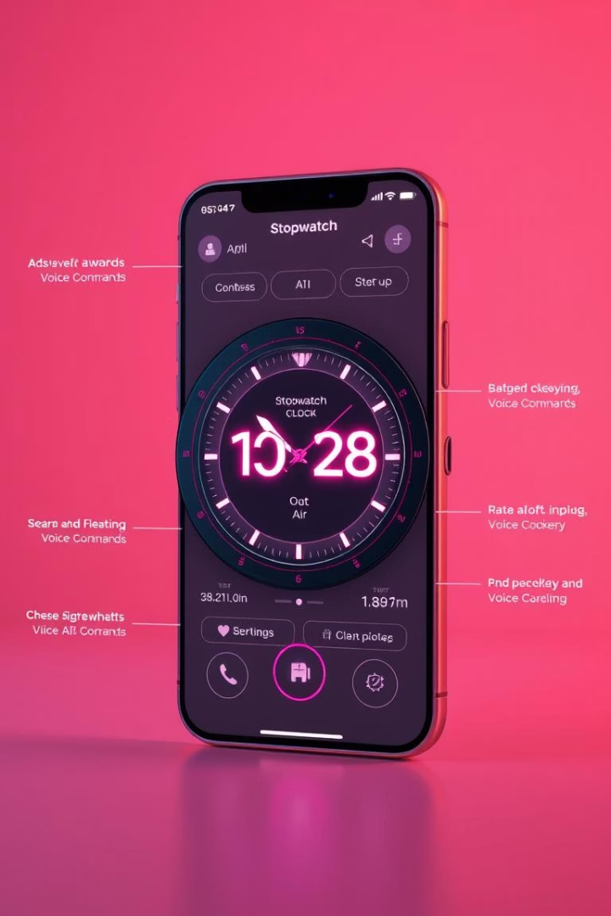
The Future of Integrated Timekeeping Tools
The evolution of these tools continues. Expect more advanced features. Integration with other smart devices will expand capabilities.
Voice Control
Hands-free operation for convenience.
AI Integration
Smart suggestions for timing activities.
Wearable Sync
Seamless connection with smartwatches.

